Slide 1
The Effect of COVID-19 on Crime Trends in Victoria
Graph visualisation is a vital tool for exploring and understanding crime data at scale.
The crime data visualisations presented here are for the public to interpret, as well as relevant criminal justice bodies - In an effort to prevent misinformation and public fear of crime.
Presented by: Ang, Thelge, Neha, Lockie

Slide 2
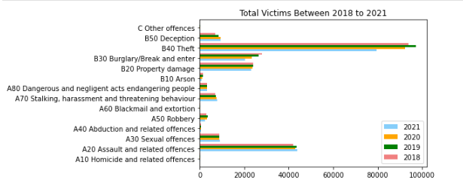
Total Victims Between 2018 to 2021
The horizontal bar graph demonstrates:
Throughout the offence subdivisions, theft had highest number of reports the last 4 years.
There was growing number of reported victims from 2018 to 2019 for most of Offence Subdivision, but Burglary/Break and Enter were decreasing.
There was decreasing number of reported victims from 2019 to 2021 for most of Offence Subdivision
There was no clear relationship between COVID time and total victims reported number

Slide 3
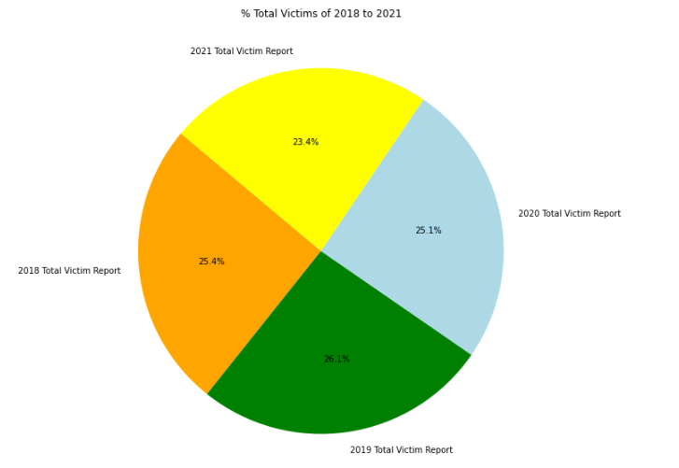
% Total Victims of 2018 to 2021
Key findings from the pie chart:
2019 had the highest number of contribution in terms of total victims reports
Total victims number was deceasing from 2020 to 2021 as percentage number was decreasing
There was no clear relationship between COVID impact and total victims reported number
Conclusion: The total number of victim reports have not been influenced by COVID-19

Slide 4
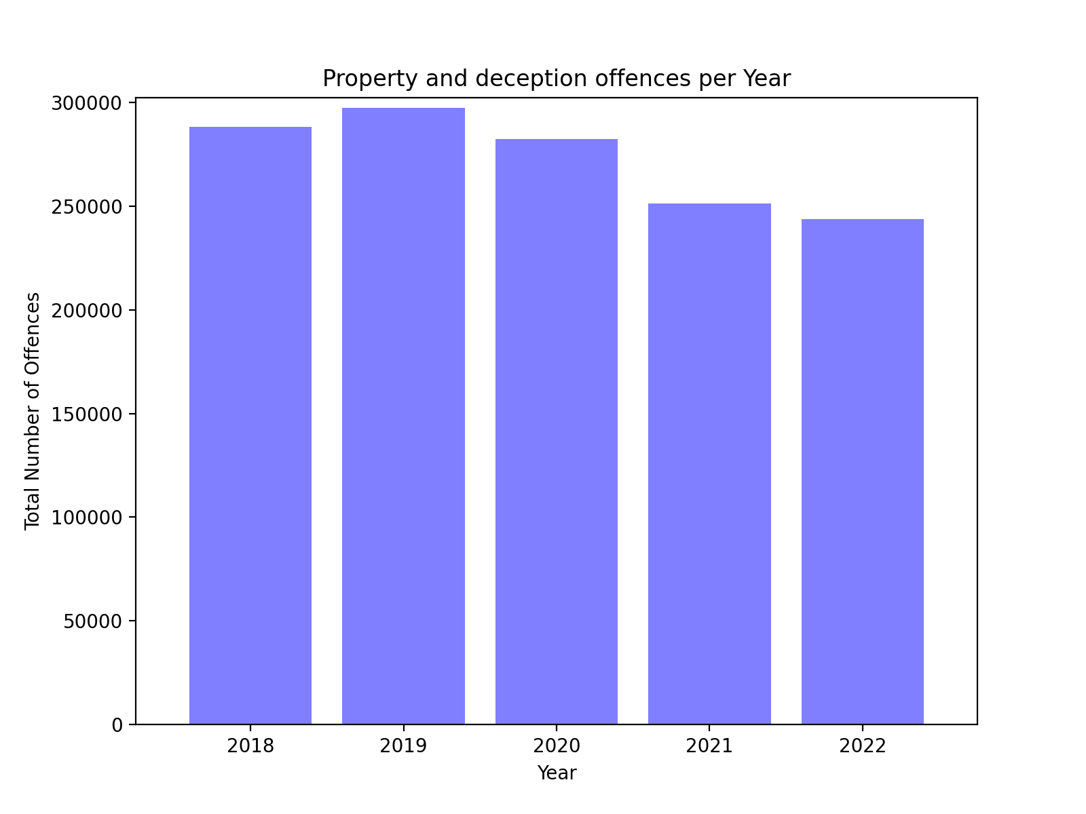
Property and Deception Offence Trend
The bar graph demonstrates:
Impact of restrictions on offences
The decrease in offences during the pandemic period 2018 to 2020
No increase in the number of offences after the ease of restrictions in 2022
Conclusion: Property and Deception offences have not been influenced by COVID-19

Slide 5
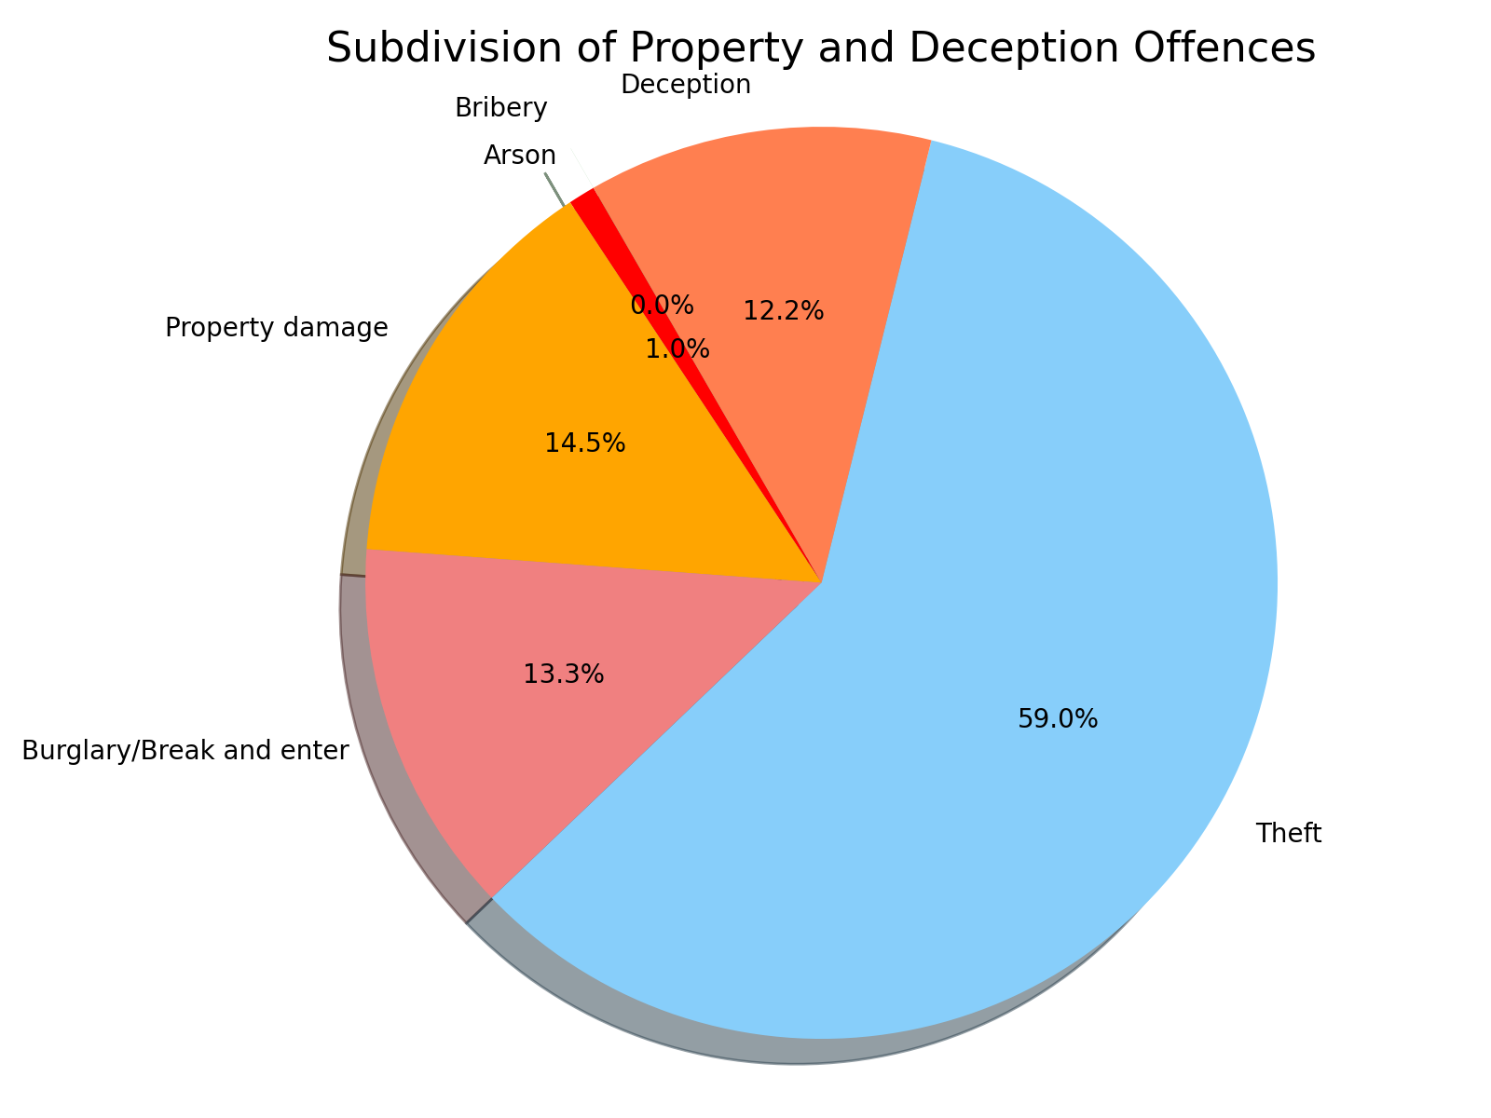
Property and Deception Offences Subdivision
The pie chart demonstrates:
The majority of offences from the findings are theft, which makes contributes to 59% of the total property and deception offences

Slide 6
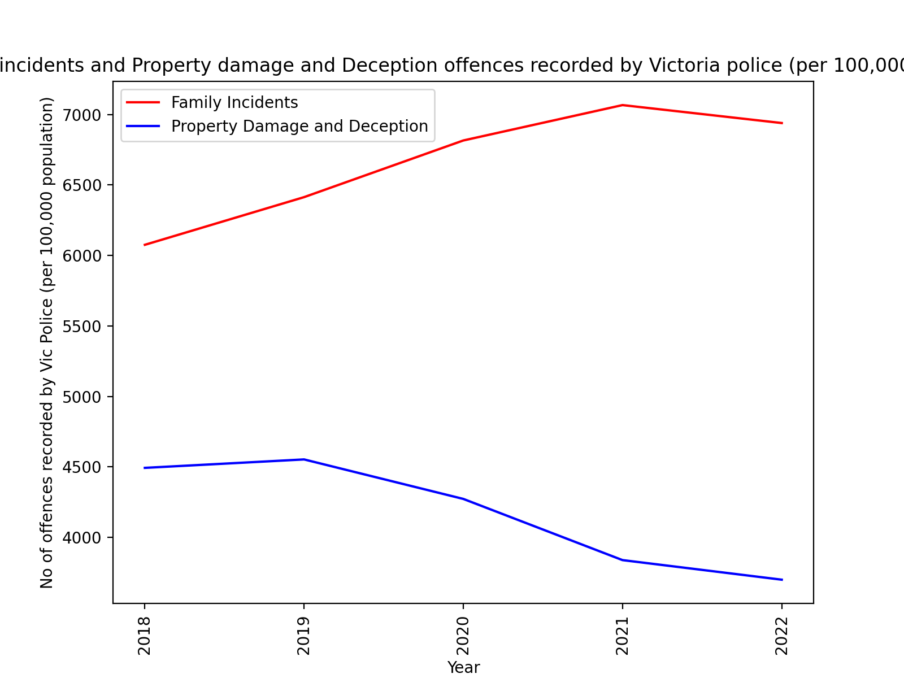
Property/Deception and Family offences trend
The findings demonstrate:
Property and Deception offences recorded per 100,000 are decreasing over time.
The visualisation displays a sharp increase of family incidents from 2018 to 2020
Family incidents started to decrease from 2021 to 2022

Slide 7
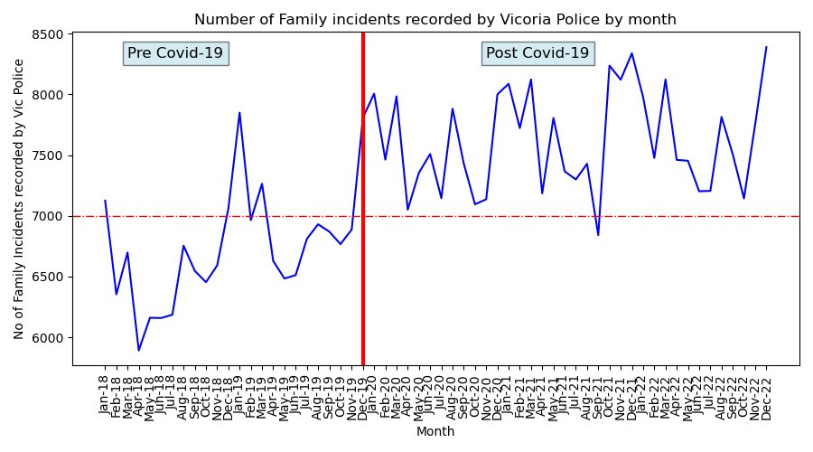
Number of Family Incidents Recorded
The findings demonstrate:
Overall upward trend
The number of Family Incidents in post COVID-19 > 7,000
The number of Family incidents pre COVID-19 < 7,000
Greater slope in pre COVID-19 period
Smaller slope in post COVID-19 period
Seasonal pattern from the visualisation

Slide 8
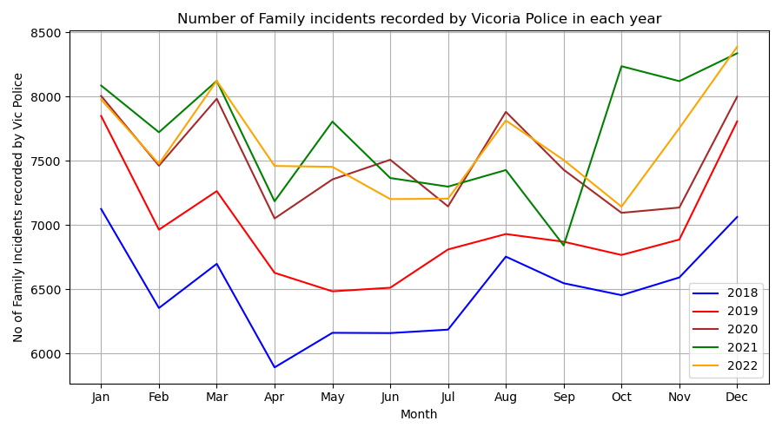
Number of Family Incidents Recorded
The findings demonstrate:
Increase in Jan, Mar, Aug and Dec from 2018 - 2022
The gap between 2019 and 2020 is > the gap between 2018 and 2019
No significant gap between trends 2020, 2021 and 2022 with the exception of 2021 August trend.
Conclusion: The growth of Family Incidents recorded has decreased in the post COVID-19 period

Slide 9
Steps followed in this section:
Define the two populations.
Detrend the time series data fitting a linear regression model.
Apply Augmented Dickey Fuller Test to find out if the detrended time series has a stochastic trend.
Then we used first differencing method to remove the stochastic trend.
Apply Augmented Dickey Fuller Test again to find out if the detrended and differenced time series is stationary.
Check if the transformed data supports normality assumption.
Perform two-sided T-test.
Number of Family Incidents Analysis

Slide 10
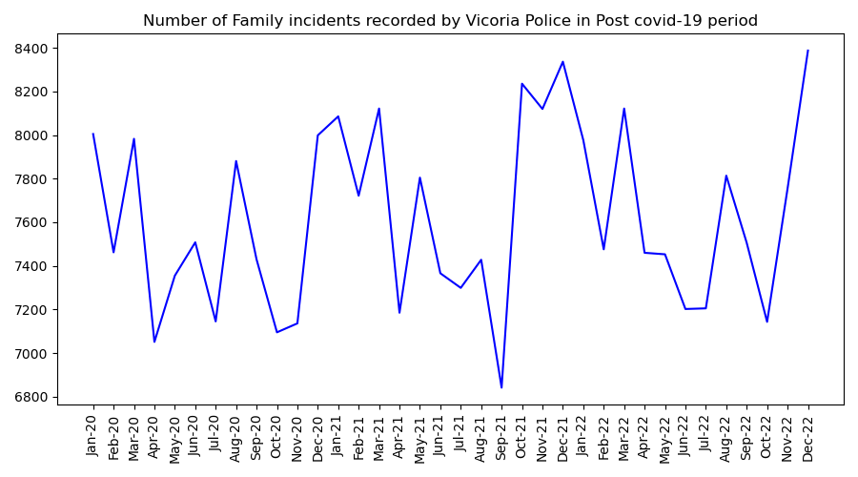
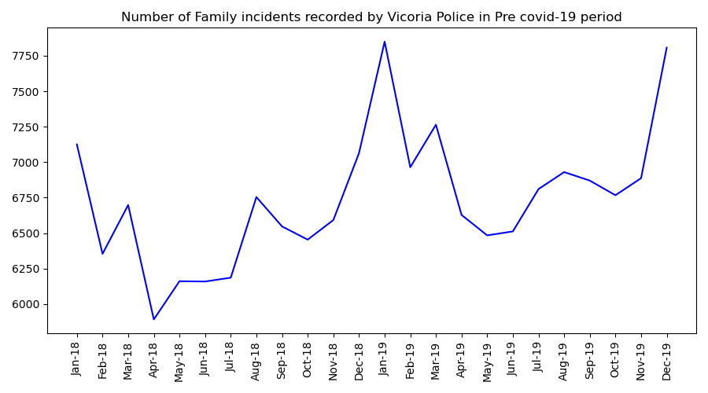
Defining the two populations

Slide 11
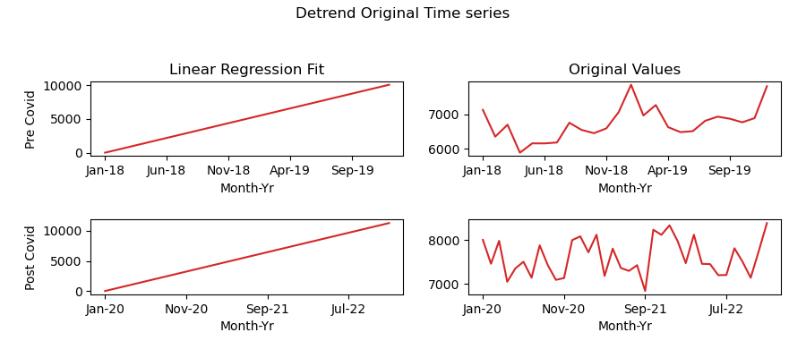
Applying linear regression
Linear model fit
Detrend by subtracting the fit model from the originals

Slide 12
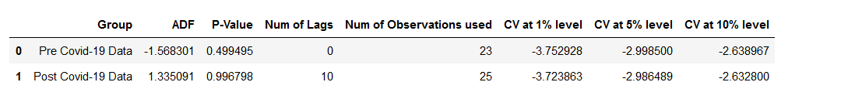
Augmented Dickey Fuller Test
Two separate ADF tests were done for each time series, pre COVID-19 and post COVID-19
The null hypothesis: Time series is not stationary
The alternate hypothesis: Time series is stationary
P- Value > 0.05
Failed to reject null hypothesis, confirming a stochastic trend in both time series

Slide 13
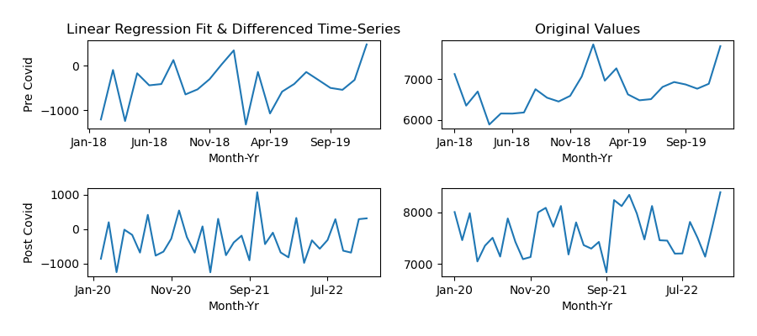
First differencing mETHOD
New column – Shift values down by one row
Subtract the shifted value from the detrend value (first value is NA in the new series)
New transformed time series – Detrended and first differencing method

Slide 14
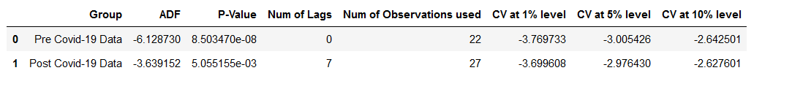
Applying Augmented dickey fuller test
Two separate ADF tests were done for each time series, pre COVID-19 and post COVID-19
The null hypothesis: Time series is not stationary
The alternate hypothesis: Time series is stationary
P- Value < 0.05, ADF is less than all critical values
There is evidence to reject the null hypothesis and consider linear regression fit and differenced time-series for both groups pre COVID-19 and post COVID-19 are stationary

Slide 15
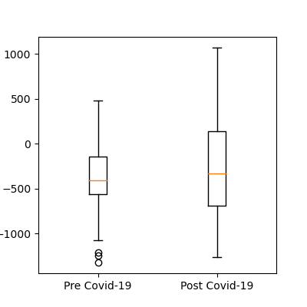
Normality Assumption
Post COVID-19 is normally distributed
Pre COVID-19 is skewed
Given that the pre COVID-19 is close to the normal distribution shape, we can assume both transformed datasets are normally distributed

Slide 16
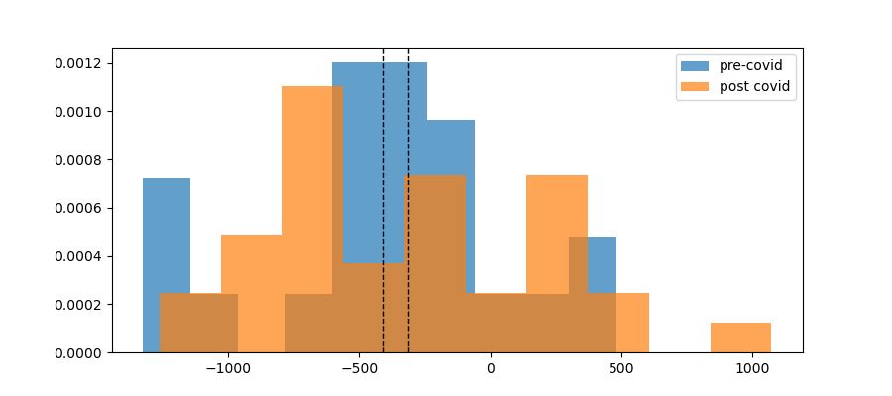
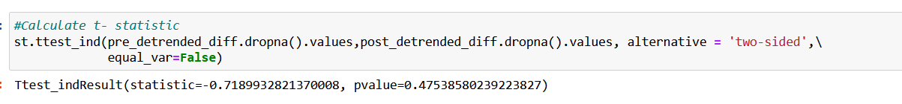
Two-sided independent t-test
Independent T-test
Assumptions are that the data is normally distributed and independent
The hypotheses for the tests: Mean of the two populations are the same
The alternate hypothesis: Mean of post COVID-19 period is significantly different from the mean of pre COVID-19 period
P-Value < 0.05
Failed to reject null hypothesis that the mean of the two populations are the same.
Conclusion: Based on the independent t-test we performed we can conclude that there is no statistically significant difference between the number of family incidents in Pre covid and post covid periods in Victoria

Slide 17
References
Crime Statistics Agency 2022, Data Tables Family Incidents Visualisation Year Ending September 2022, accessed 7 January 2022, https://www.crimestatistics.vic.gov.au/crime-statistics/latest-victorian-crime-data/download-data.
Crime Statistics Agency 2022, Data Tables Criminal Incidents Visualisation Year Ending September 2022, accessed 9 January 2022, https://www.crimestatistics.vic.gov.au/crime-statistics/latest-victorian-crime-data/download-data.
Crime Statistics Agency 2022, Data Tables Victim Reports Visualisation Year Ending September 2022, accessed 9 January 2022, https://www.crimestatistics.vic.gov.au/crime-statistics/latest-victorian-crime-data/download-data.
Jason Brownlee. (2020, August 15). How to Identify and Remove Seasonality from Time Series Data with Python [Blog post]. Retrieved from https://machinelearningmastery.com/time-series-seasonality-with-python/#:~:text=A%20simple%20way%20to%20correct,the%20value%20from%20last%20week.
Sunny Solanki. (2022, August 27). How to Remove Trend & Seasonality from Time-Series Data [Python]? [Blog post]. Retrieved from https://coderzcolumn.com/tutorials/data-science/how-to-remove-trend-and-seasonality-from-time-series-data-using-python-pandas

